Slide 1
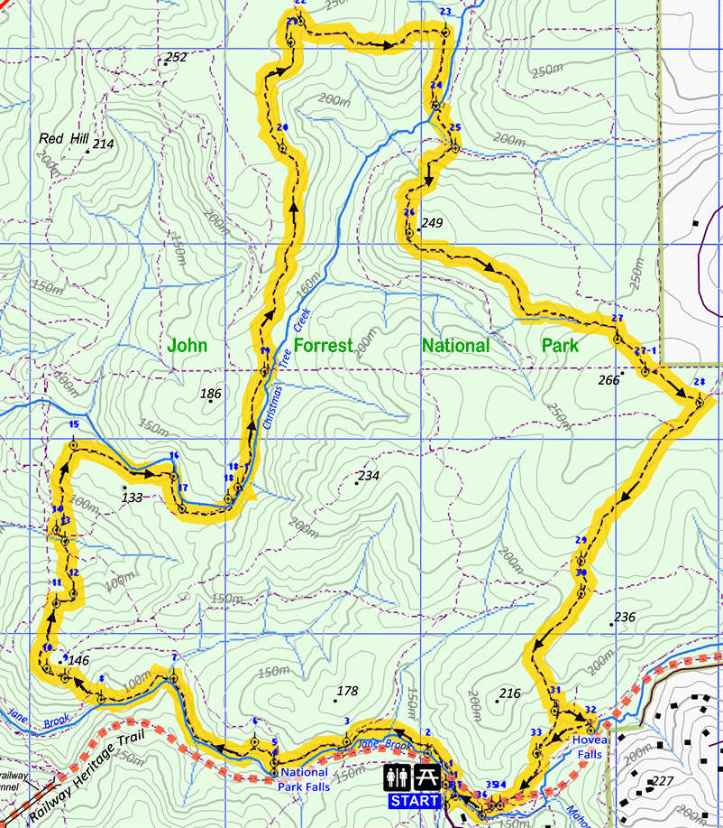
As part of a search and rescue effort, you are required to fly a IR camera drone from the starting position to 3 points and home again. You know the drone can fly 4km on a single charge. If each 1 unit on the grid = 100m, can it make this distance?

Slide 2
On the graph below, plot the following points:
a) (3, 5) f) (–1, 4)
b) (2, –1) g) (3, –3)
c) (– 3, – 4) h) (0, 0)
d) (5, 0) i) (5½, – 1)
e) (0, 2) j) (–3, 3)

Slide 3
On the graph below, plot the following points:
a) (3, 5) f) (–1, 4)
b) (2, –1) g) (3, –3)
c) (– 3, – 4) h) (0, 0)
d) (5, 0) i) (5½, – 1)
e) (0, 2) j) (–3, 3)
•a
•f
•j
•e
•h
•d
•b
•i
•g
•c

Slide 4
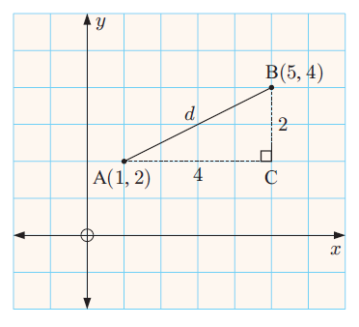

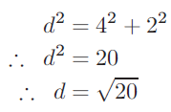
Topic :
24
7
30
Date
EQ :
How do we find the distance between 2 points?
Using Pythagoras.
d² = a² + b²
d = 4.47

Slide 5
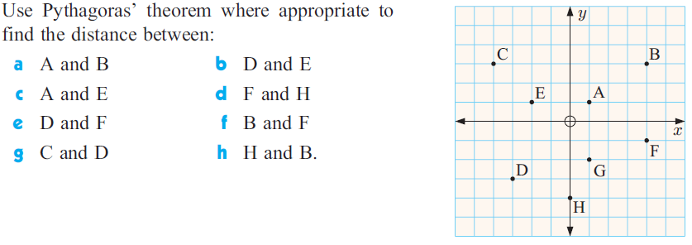
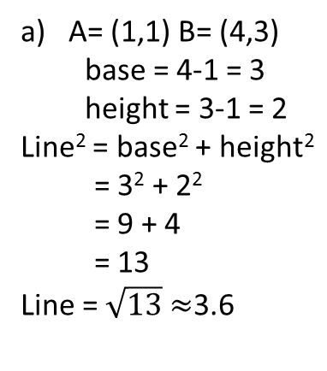
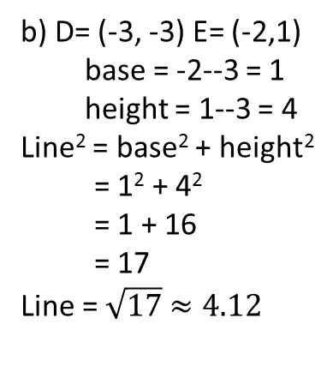
Let’s try these….
A= (1,1) B= (4,3)
base = 4-1 = 3
height = 3-1 = 2
Line² = base² + height²
= 3² + 2²
= 9 + 4
= 13
Line = $\sqrt{13}$ $≈$3.6
b) D= (-3, -3) E= (-2,1)
base = -2--3 = 1
height = 1--3 = 4
Line² = base² + height²
= 1² + 4²
= 1 + 16
= 17
Line = $\sqrt{17}$ $≈4.12$

Slide 6
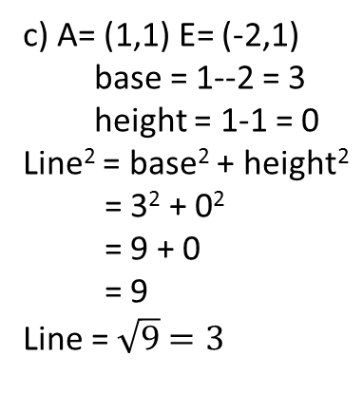
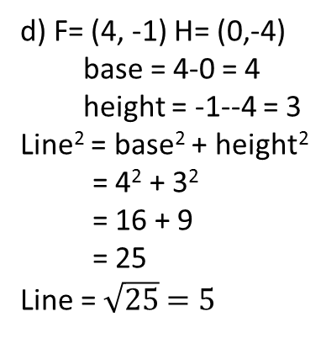
Let’s try these….
c) A= (1,1) E= (-2,1)
base = 1--2 = 3
height = 1-1 = 0
Line² = base² + height²
= 3² + 0²
= 9 + 0
= 9
Line = $\sqrt{9}$ $=3$
d) F= (4, -1) H= (0,-4)
base = 4-0 = 4
height = -1--4 = 3
Line² = base² + height²
= 4² + 3²
= 16 + 9
= 25
Line = $\sqrt{25}$ $=5$

Slide 7
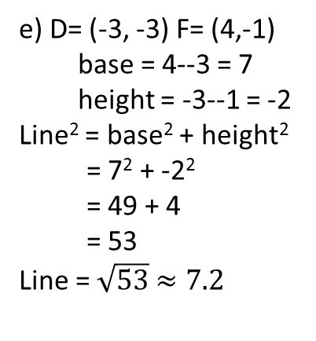
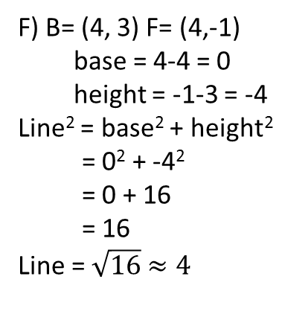
Let’s try these….
e) D= (-3, -3) F= (4,-1)
base = 4--3 = 7
height = -3--1 = -2
Line² = base² + height²
= 7² + -2²
= 49 + 4
= 53
Line = $\sqrt{53}$ $≈7.2$
F) B= (4, 3) F= (4,-1)
base = 4-4 = 0
height = -1-3 = -4
Line² = base² + height²
= 0² + -4²
= 0 + 16
= 16
Line = $\sqrt{16}$ $≈4$

Slide 8
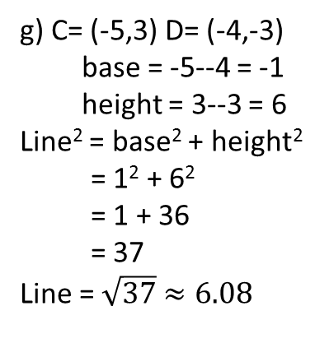
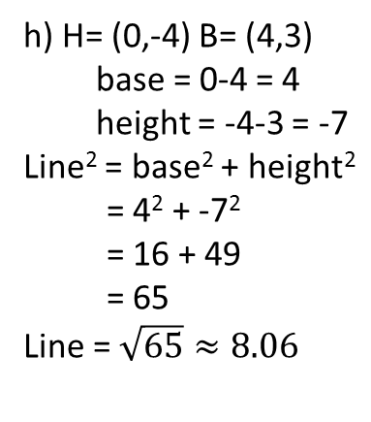
Let’s try these….
g) C= (-5,3) D= (-4,-3)
base = -5--4 = -1
height = 3--3 = 6
Line² = base² + height²
= 1² + 6²
= 1 + 36
= 37
Line = $\sqrt{37}$ $≈6.08$
h) H= (0,-4) B= (4,3)
base = 0-4 = 4
height = -4-3 = -7
Line² = base² + height²
= 4² + -7²
= 16 + 49
= 65
Line = $\sqrt{65}≈8.06$

Slide 9
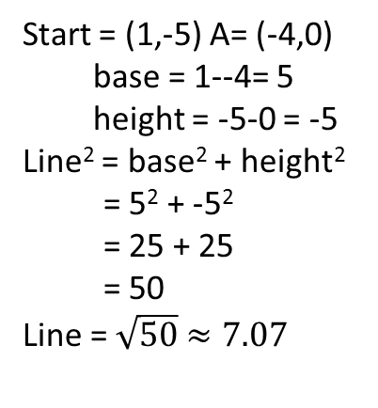
As part of a search and rescue effort, you are required to fly a IR camera drone from the starting position to 3 points and home again. You know the drone can fly 4km on a single charge. If each 1 unit on the grid = 100m, can it make this distance?
Start = (1,-5) A= (-4,0)
base = 1--4= 5
height = -5-0 = -5
Line² = base² + height²
= 5² + -5²
= 25 + 25
= 50
Line = $\sqrt{50}$ $≈7.07$

Slide 10

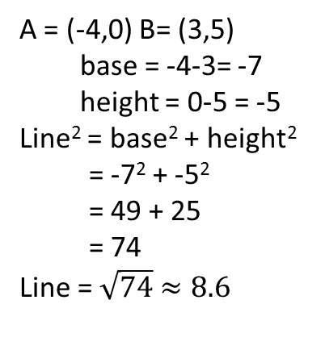
As part of a search and rescue effort, you are required to fly a IR camera drone from the starting position to 3 points and home again. You know the drone can fly 4km on a single charge. If each 1 unit on the grid = 100m, can it make this distance?
Start to A = $7.07=707m$
A = (-4,0) B= (3,5)
base = -4-3= -7
height = 0-5 = -5
Line² = base² + height²
= -7² + -5²
= 49 + 25
= 74
Line = $\sqrt{74}$ $≈8.6$

Slide 11

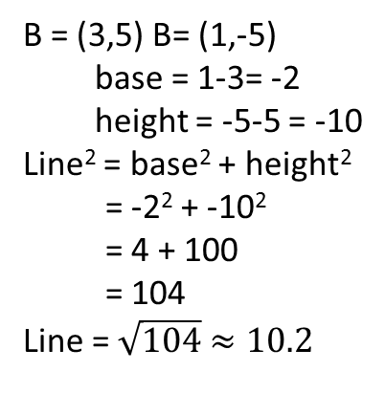
As part of a search and rescue effort, you are required to fly a IR camera drone from the starting position to 3 points and home again. You know the drone can fly 4km on a single charge. If each 1 unit on the grid = 100m, can it make this distance?
Start to A = $7.07=707m$
A to B = $8.6$ = 860m
B = (3,5) B= (1,-5)
base = 1-3= -2
height = -5-5 = -10
Line² = base² + height²
= -2² + -10²
= 4 + 100
= 104
Line = $\sqrt{104}$ $≈10.2$

Slide 12


As part of a search and rescue effort, you are required to fly a IR camera drone from the starting position to 3 points and home again. You know the drone can fly 4km on a single charge. If each 1 unit on the grid = 100m, can it make this distance?
Start to A = $7.07=707m$
A to B = $8.6$ = 860m
B to Start = $10.2=1020m$
Total = 2587m or 2.587 km so yes your drone will fly far enough.

Slide 13
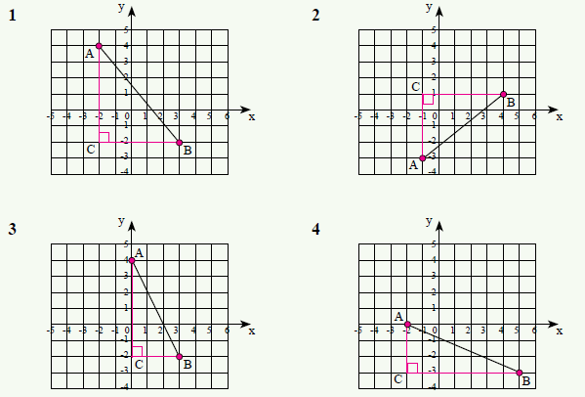
Ex 16.1 and 16.2 of Year 9 text. Page 214 to 215.

Slide 14
